Slide 1
EcoBourne
A civic currency for Eastbourne

Slide 2
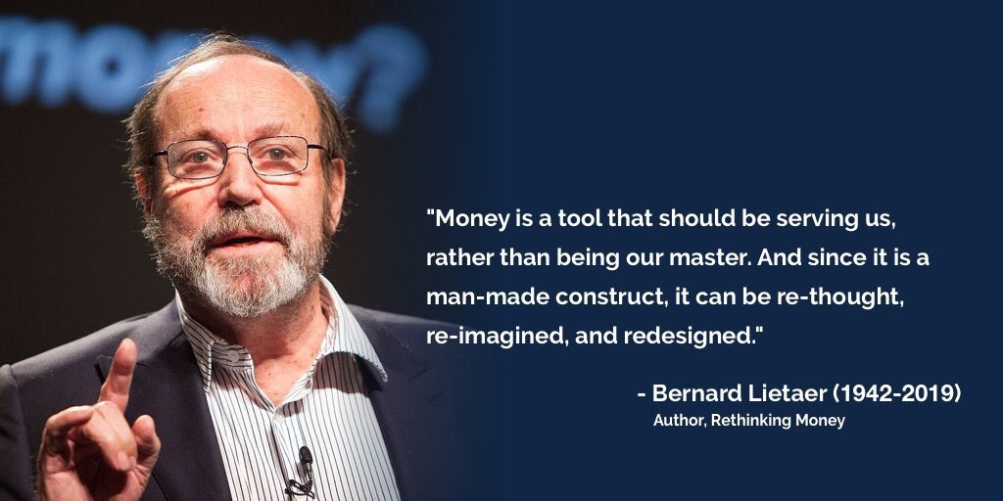

Slide 3
EcoBourne: seedcorn for a greener Eastbourne
a digital currency that incentivises local people to engage in actions that provide a measurable benefit for the local environment.
by earning & spending EcoBournes, local people would be planting seeds for the sprouting of a local money tree, producing the fruit of natural ecosystem benefits that increase the health & wellbeing of both people & wildlife.

Slide 4
EcoBourne:
Why create a new currency when pounds will do?
Most of nature, & actions to protect/enhance it, are not valued in pounds.
Transactions in pounds create profits for institutions like banks that invest in activities that destroy nature.
A truly local currency keeps economic value circulating within the local area rather than leaking out of it.

Slide 5
EcoBourne:
How can EcoBournes be earned?
Rewards for engaging with conversations on Eastbourne Friends of the Earth social media networks, as well as on partner networks of civic discourse.
Rewards for participation in environmental activities in Eastbourne area - eg. litter picking, plastic recycling.
Payments for creation of natural capital assets around Eastbourne - eg. tree/hedge planting, new wildlife habitats.

Slide 6
EcoBourne:
How can EcoBournes be spent?
at any local or national retail outlet or business that is accredited as being ethical from an environmental perspective.
by making donations to local environmental projects, groups or activists, or by making tips to posters on local civic forums.
by investing in local enterprises that seek to improve/protect the local environment.

Slide 7
Designing the EcoBourne
As the EcoBourne will be a community currency, it will be co-created & co-governed by local community groups through facilitated collaboration between them.
The impact of the EcoBourne will be measured through social value & natural value metrics.
The day-to-day management of the EcoBourne will be facilitated by a digital platform designed with the assistance of digital tech experts.

